Slide 1
Understanding User Needs for Carbon Monitoring Information
Riley Duren¹, Molly Macauley², Kevin Gurney³, Sassan Saatchi¹, Chris Woodall⁴, Bogdan Oaida¹, David Reidmiller⁵, Leif Hockstad⁶, Melissa Weitz⁶, Bart Croes⁷, Kate Larsen⁸, Dan Crichton¹, Roger Cooke², Elke Hodson⁹, Yanna Antypas¹⁰, Tris West¹¹
Riley.m.duren@jpl.nasa.gov
¹Jet Propulsion Laboratory
² Resources For the Future
³Arizona State University
⁴US Forest Service
⁵US State Department
⁶US Environmental Protection Agency
⁷California Air Resources Board
⁸Rhodium Group
⁹DOE Energy Policy and Systems Analysis
¹⁰DOE Energy Information Administration
¹¹White House Council on Environmental Quality
Under the UNFCCC and carbon fund, what’s a reasonable level of uncertainty at a national scale?
Under the UNFCCC and carbon fund, what’s a reasonable level of uncertainty at a national scale?
How do we diagnose and reconcile reported discrepancies between top-down & bottom-up emission estimates for sector X?
How do we diagnose and reconcile reported discrepancies between top-down & bottom-up emission estimates for sector X?
Can we separate with confidence the sectors/processes driving changes in CH4 budgets at regional to national scales?
Can we separate with confidence the sectors/processes driving changes in CH4 budgets at regional to national scales?
(State/Province) Are the MRV systems of other sub-national carbon markets sufficiently robust for us to link to our market?
(State/Province) Are the MRV systems of other sub-national carbon markets sufficiently robust for us to link to our market?
What’s the true magnitude of carbon losses from peatland draining in Indonesia and Malaysia?
What’s the potential for future inclusion of blue carbon in national GHG inventories?
What are the carbon-cycle impacts (desired and unintended) of approved or rogue geoengineering field-experiments?
What’s the true magnitude of carbon losses from peatland draining in Indonesia and Malaysia?
What’s the potential for future inclusion of blue carbon in national GHG inventories?
What are the carbon-cycle impacts (desired and unintended) of approved or rogue geoengineering field-experiments?
Should we include LULUCF fluxes in our upcoming stabilization commitment given current uncertainties in the trend?
Should we include LULUCF fluxes in our upcoming stabilization commitment given current uncertainties in the trend?
Should we use facility-level verification or basin-level validation to track fugitive CH4 emission from natural gas production?
Should we use facility-level verification or basin-level validation to track fugitive CH4 emission from natural gas production?
What emission factors should we assign to biodiesel from palm oil? Coastal wetlands?
What emission factors should we assign to biodiesel from palm oil? Coastal wetlands?
What’s the cost per level of uncertainty associated with forest monitoring systems?
Will (country-A) land sink remain a sink beyond 2020?
How do I (mayor) convince my electorate that the city’s climate plan is working and is worth the cost?
What’s the cost per level of uncertainty associated with forest monitoring systems?
Will (country-A) land sink remain a sink beyond 2020?
How do I (mayor) convince my electorate that the city’s climate plan is working and is worth the cost?
Is it possible to measure forest degradation at the national scale with latencies < 2 years - and at what cost?
Is it possible to measure forest degradation at the national scale with latencies < 2 years - and at what cost?
Are fracking regulations having the intended impact on fugitive CH4 emissions at the scale of major shale basins?
Are fracking regulations having the intended impact on fugitive CH4 emissions at the scale of major shale basins?

Slide 2
Systems approach for CMS
Approach:
  Engage users to identify stakeholder questions (sustained policy/science team)
  Derive requirements for carbon information/data sets and supporting observations
  Evaluate CMS data products for decision making value
  Explore visualization/sharing of carbon information (& uncertainties)
Timeline:
  Discovery
    Initial user engagement
    Existing/planned CMS products
  Analyze and design
    Policy Scenarios & Requirements Analysis
    Carbon Calculator requirements/interfaces
  Develop, integrate, test
    Carbon Calculator tool development
    Integrated CMS products
  Evaluate CMS products
  Communicate, iterate, evolve
Skim this
Yr
1
Yr
2-3

Slide 3
Initial findings
Finding-1: Reducing uncertainty in current and future emissions and removals from the land sector in the US, particularly attribution of natural vs anthropogenic causes, is a significant priority with domestic and international policy implications.
Finding-2: Providing policy-relevant data on the fossil-fuel CO2 emissions and forestry and agricultural carbon offsets of sub-national entities (including emerging linked carbon trading programs between states, provinces, cities, and land owners across international borders) may prove equally important to supporting verification (MRV) of national greenhouse gas inventories.
Finding-3: Reducing uncertainty and inconsistency in the quantification and sectoral attribution of fugitive methane (CH4) emissions can help to inform climate mitigation action by US national, state, and local governments and by other entities globally. → will say more about this
Finding-4: Identifying the limits and capabilities of carbon estimation and monitoring systems is an important input to policymaking (sometimes as important as the data products themselves).
Finding-5: Data that enables improved short-term carbon forecasts and long-term carbon/climate projections may prove critical for better Integrated Assessment Models and more robust policy metrics such as the “social cost of carbon”.
Finding-6: Uncertainty quantification and communication for carbon stock and flux data is important but the specific needs and priorities are likely strongly application- and stakeholder-dependent and/or could require different approaches not immediately available from the CMS program.

Slide 4
Additional observations
“MRV” is complex, nuanced, often misunderstood – and necessary but not sufficient → will say more about this
Major challenge themes – implications on WHAT is needed*
  US (federal/state/local): enabling mitigation (vs inventorying) key sectors
  Developing world: Fossil Fuel CO2 and CH4 data gaps (activity and EF’s)
  Connecting atmospheric data to decision-making (relevance, timeliness)
*distinct from HOW to deliver data for relatively well-defined needs (e.g., forest carbon/REDD+)

Slide 5
Finding 3: linking driving questions to observational requirements for methane
Driving question | Needed information | Observational requirements
What are the causes of recent observed changes in the global atmospheric CH4 growth rate and how might this change in the future (in response to climate change and human activity)? | Relative CH4 fluxes of wetlands, fossil-fuel use, agriculture at regional (50 km) and seasonal resolution; controlling processes/sensitivities | Global (or regional) CH4 mixing ratio measurements; key surface process variables (e.g., Ts, Inundation state, disturbances), others?
What is the actual US CH4 budget and why do large discrepancies persist between bottom-up and top-down estimates for key sectors? | Improved activity data and emission factors; comparable T-D and B-U data sets; attribution | Tracer-tracer obs (CH4, C2H6, CO, VOCs?) for key regions/sectors*; common CH4 data set for comparison
How significant are CH4 leaks in the US fossil fuel (natural gas, oil, coal) supply chain, where are the dominant leak sources located, and can they be repaired expeditiously? | Facility level reporting; persistent and complete monitoring of potential sources (~ 40% CONUS) with low latency notification (days) | Wide-area, persistent scanning (threshold detection) for intense CH4 point sources; rapid flux estimation
What are the CH4 emissions from other regions and sectors (particularly developing countries) and how are they responding to mitigation efforts? | Improved activity data and emission factors; comparable T-D and B-U data sets; attribution | Tracer-tracer obs for key regions/sectors(CH4, C2H6, CO, VOCs?) **; activity data proxies (imaging)
(partially) addressed by CMS program
*Key sectors in US include: agriculture/livestock and natural gas supply chain
**Key sectors in developing world vary by country but include: agriwaste, livestock, reservoirs and fossil fuel production
Notes:
*Key sectors in US include: agriculture/livestock and natural gas supply chain
**Key sectors in developing world vary by country but include: agriwaste, livestock, reservoirs and fossil fuel production

Slide 6
Methane: Space-time scales of key questions, required information, and supporting observations
Native resolution (single observation)
Derived (L4) data products
Scale of key questions
365
90
16
1
0.1
nested,
meso-scale CH4 inversions
& mass-balance
National- Continental scale CH4 budgets
Wetlands
Feed lots
Oil/gas field
Oil/gas wells
GOSAT/TropOMI
global CH4 flux
inversions
Temporal
Resolution
(days)
GOSAT (sort of)
Uncertainty
Landsat
TropOMI
ACTIVITY DATA vs EMISSION FACTORS
Point-source imaging (threshold detection)
Fluxnet (typical
EC tower footprint)
0.1 1 10 100 1000
Spatial Resolution (horizontal, km)
Uncertainty
Notes:
SMAP native resolution: 3 km (SAR) and 40 km (radiometer); 3 day revisit
OCO native resolution: 1.7 km, 16 day revisit

Slide 7
MRV (&V) - what problem(s) are we solving?
Mitigation Policies & Programs
(UNFCCC CDM, REDD+, Emission Trading Systems, etc)
Measurement, Reporting & Verification (MRV) frameworks
Project-level forest carbon data
Carbon Registries
GHG inventories & reporting
(e.g., EPA)
Facility-level reporting
Aggregated Source/Sink fluxes (F) by sector
Continuous Emission Monitoring or Calculation
*surface physical manifestations of energy use (e.g., nightlights, urban form, etc)
F = A * EF
Activity (A) data and statistics (e.g., EIA, FIA)
Emission factors (EF) databases
Validation
Earth Observations
Land Carbon Stocks & Fluxes
Energy Activity*
Atmospheric Carbon
Ocean Carbon

Slide 8
MRV ≠ Earth Observations*
The M part of MRV is alternately (and inconsistently) referred to as “measurement” and “monitoring” and in the current MRV world mostly does NOT refer to earth observations* – rather, collection of activity data (e.g. fuel statistics or forest stocks) & emission factors
Physical measurement/characterization contributes indirectly to the “measurement/monitoring” aspect of MRV (e.g., through infrequent sampling of key sectors, processes or areas to inform inventories of activity data and emission factors)
Direct, near-continuous sampling of emission fluxes from selected facilities (e.g., meters at large power plants) and direct reporting are sometimes used for internal validation of sectoral data within inventories
Earth observations (what the science community usually equates to “measurements” - or “monitoring” when done in a sustained fashion) are mostly not yet part of MRV frameworks*
  Recent movement with MRV community is to consider ways for earth obs to improve fidelity or gap-fill activity data and emission factors; this is quite distinct from independent “verification”
*some forms of remote-sensing (e.g., forest land imaging) are already recognized as MRV contributors, particularly “tier 3” reporting for REDD+, however the same is not true for atmospheric observations and other observations relevant to energy statistics, other key activity
Skip this

Slide 9
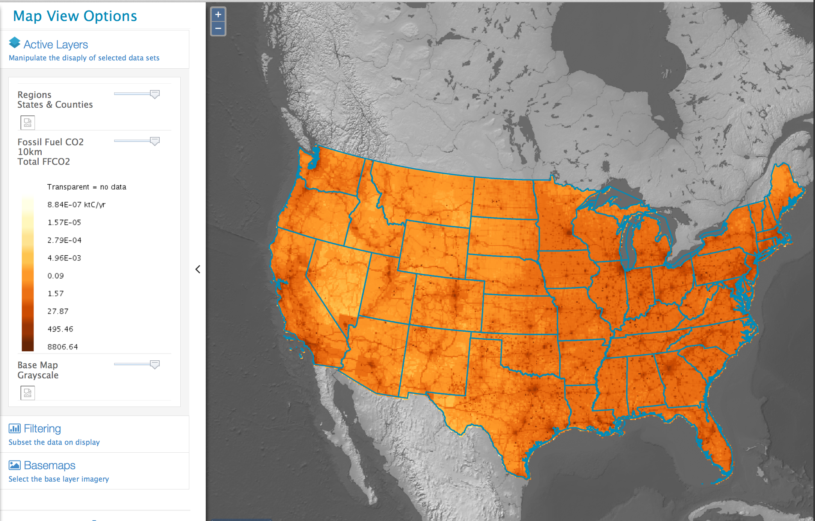
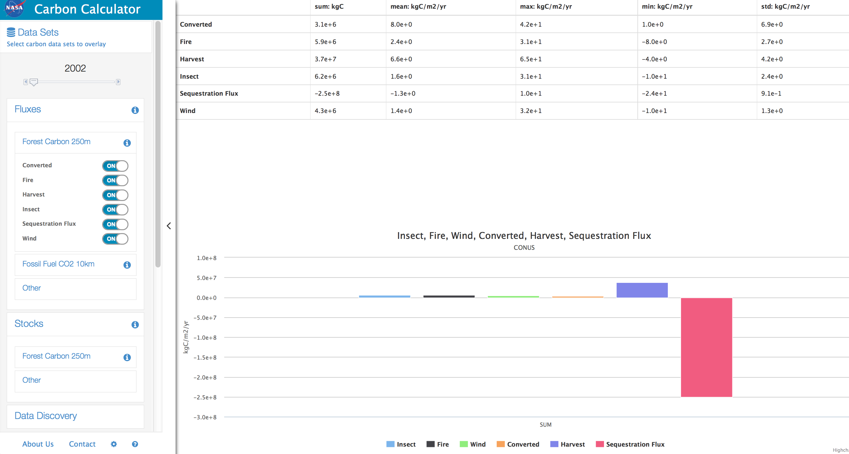
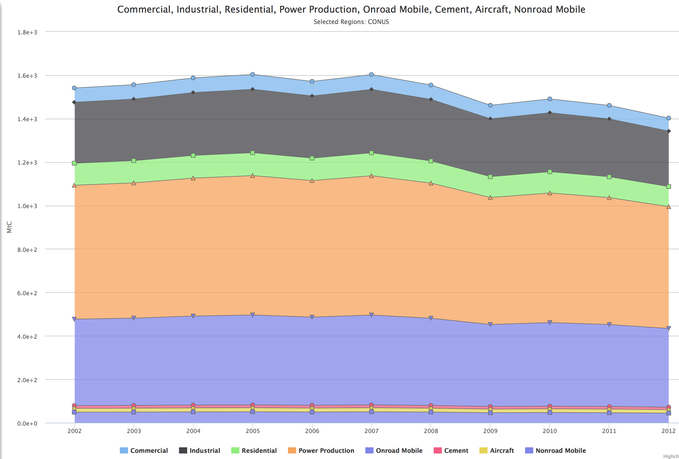
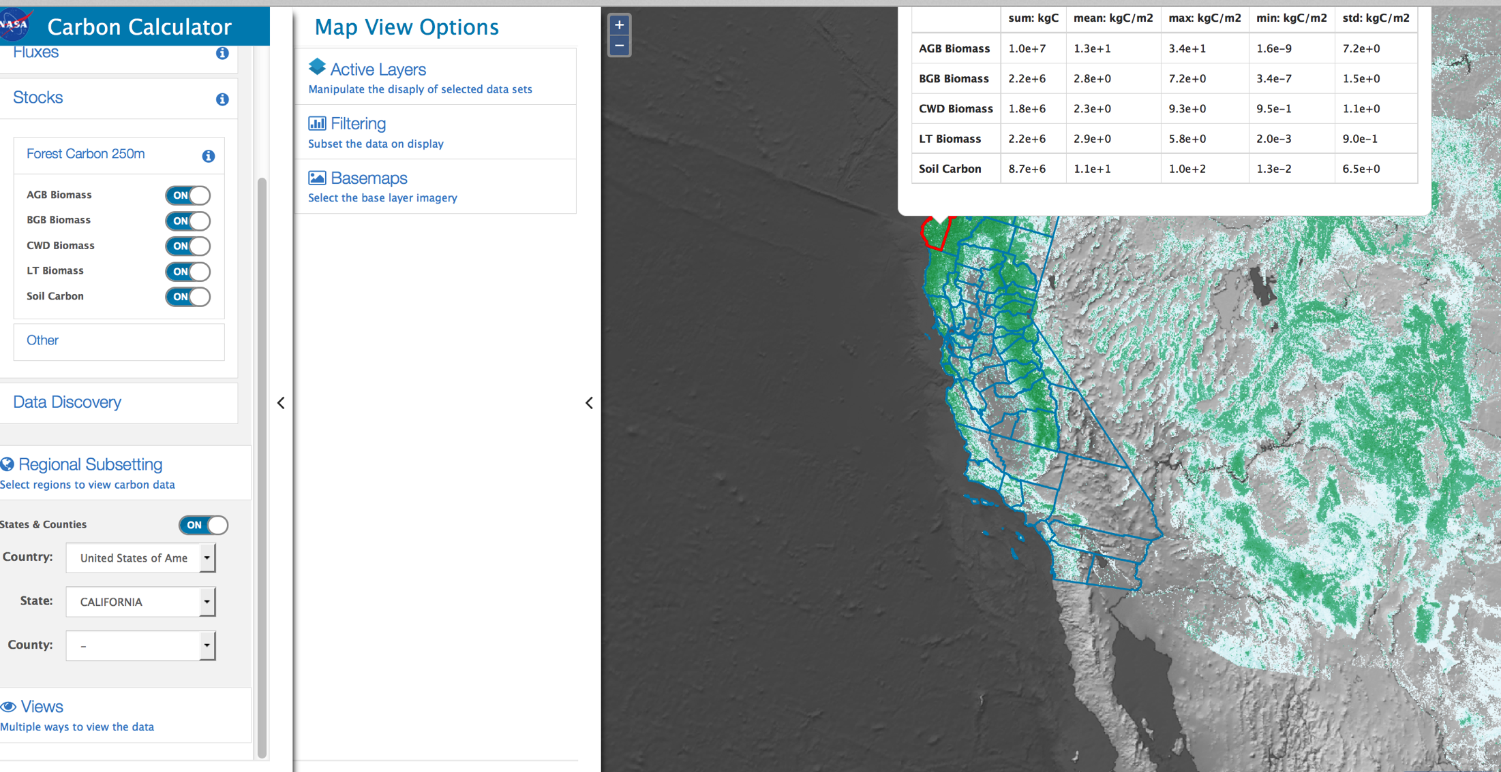
web demo goes here

Slide 10
Carbon Calculator lessons-learned
Grid & projections
Scale mismatch
Meta-data
Units
VALIDATION!
Comparing “apples and oranges”
Communicating uncertainty

Slide 11
Shameless plugs
(please join us for)
UN COP-20 meeting in Lima, Dec 5, US Center
  Megacities Carbon Project side event (NIST/NASA) http://megacities.jpl.nasa.gov
AGU sessions on urban carbon monitoring (100 talks)
  Quantifying emissions from urban and other complex areas (A51Q, A52D, A53L, A53M)
  Urban areas and global change (B13I, B23J, B24D)
NACP sessions on urban carbon and methane monitoring

Slide 12
backup

Slide 13
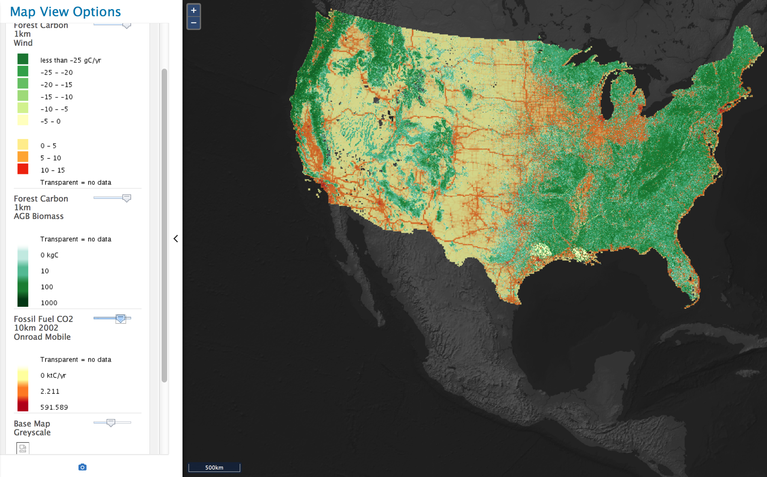
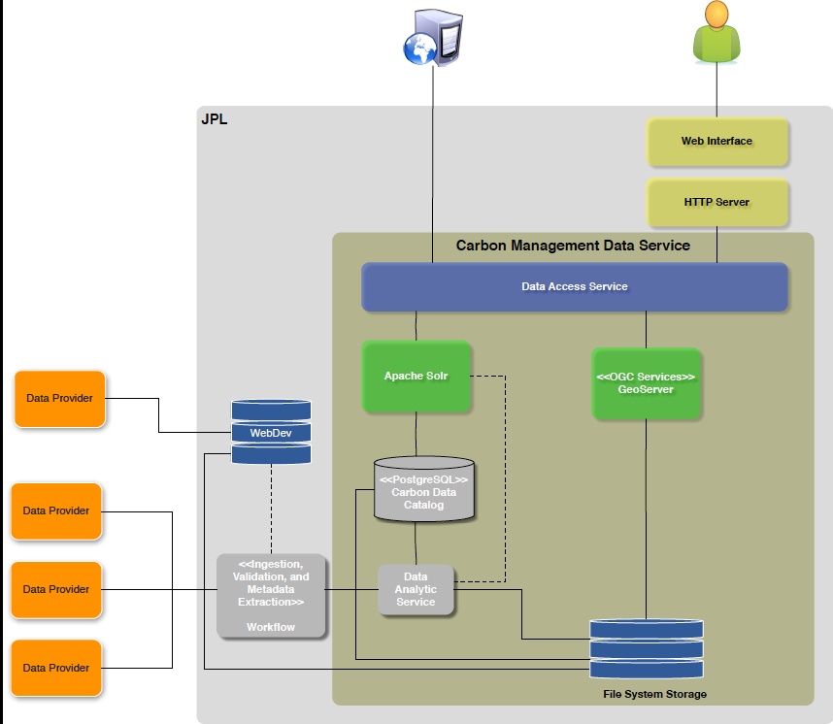
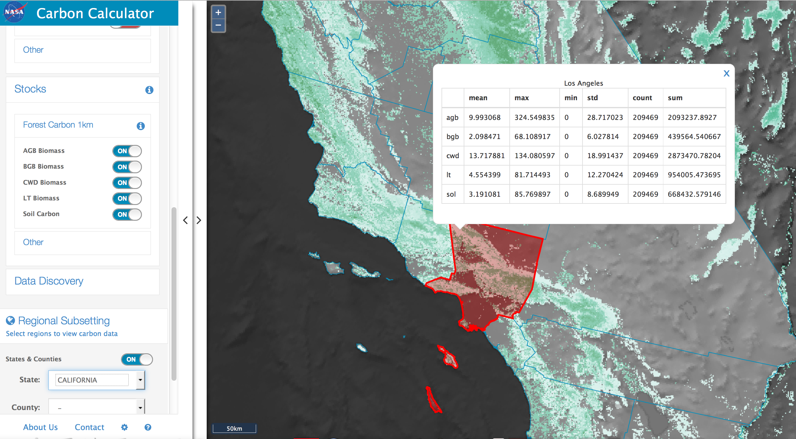
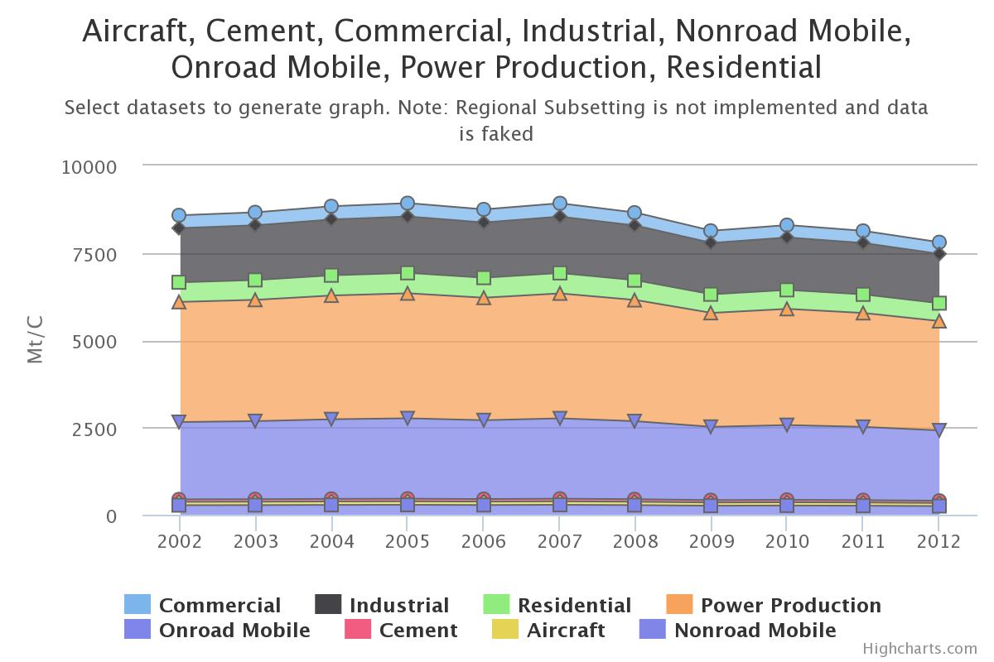
Carbon Calculator tool
(for product evaluation)
Initial data sets
Vulcan FFCO2 (Gurney et al)
US forest fluxes (Saatchi et al)
US forest stocks
(Saatchi et al)

Slide 14
Fossil Fuel CO2 fluxes (Vulcan, 2002)

Slide 15
Fossil Fuel CO2 fluxes (Vulcan, 2002)
Post-2002 data is scaled using
CDIAC (placeholder)

Slide 16
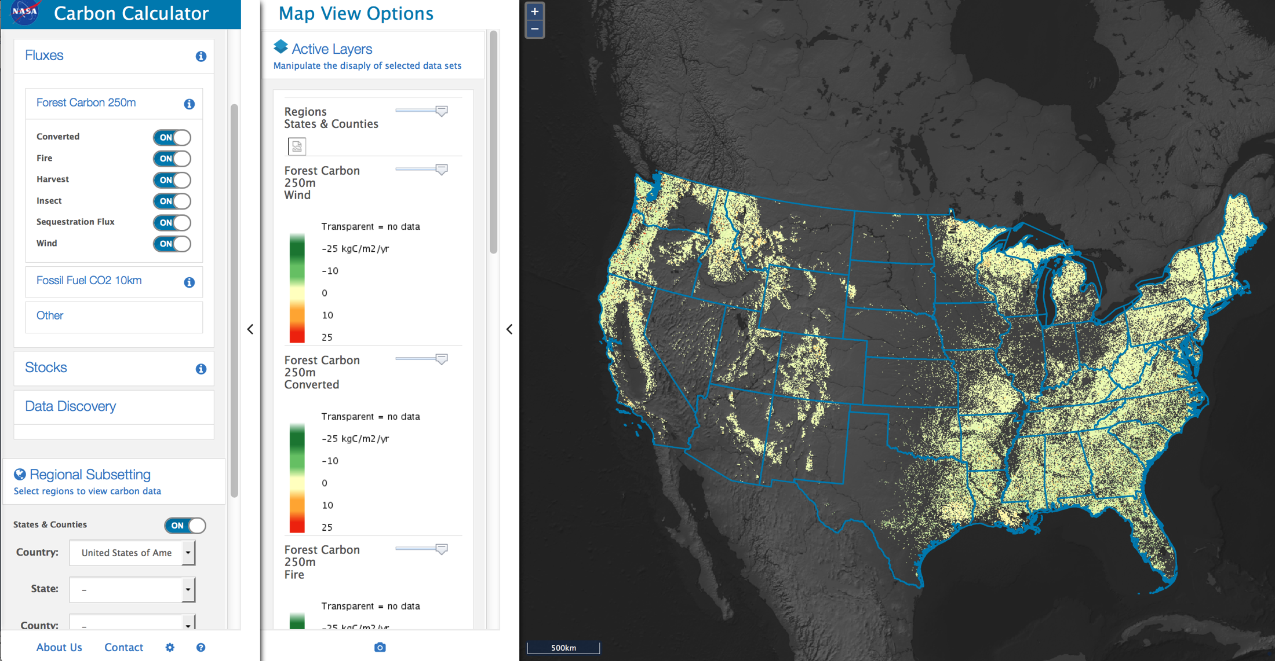
Forest carbon fluxes (Saatchi et al 2010)

Slide 17
Forest carbon fluxes (Saatchi et al 2010)

Slide 18
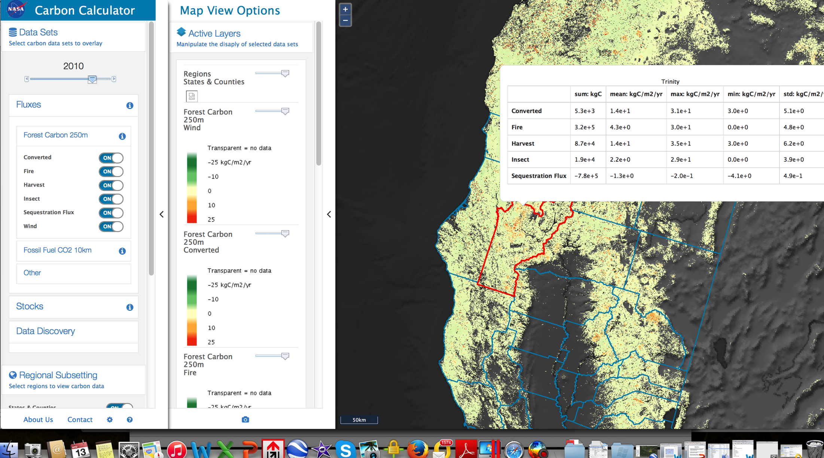
Forest carbon fluxes (Saatchi et al 2010)

Slide 19
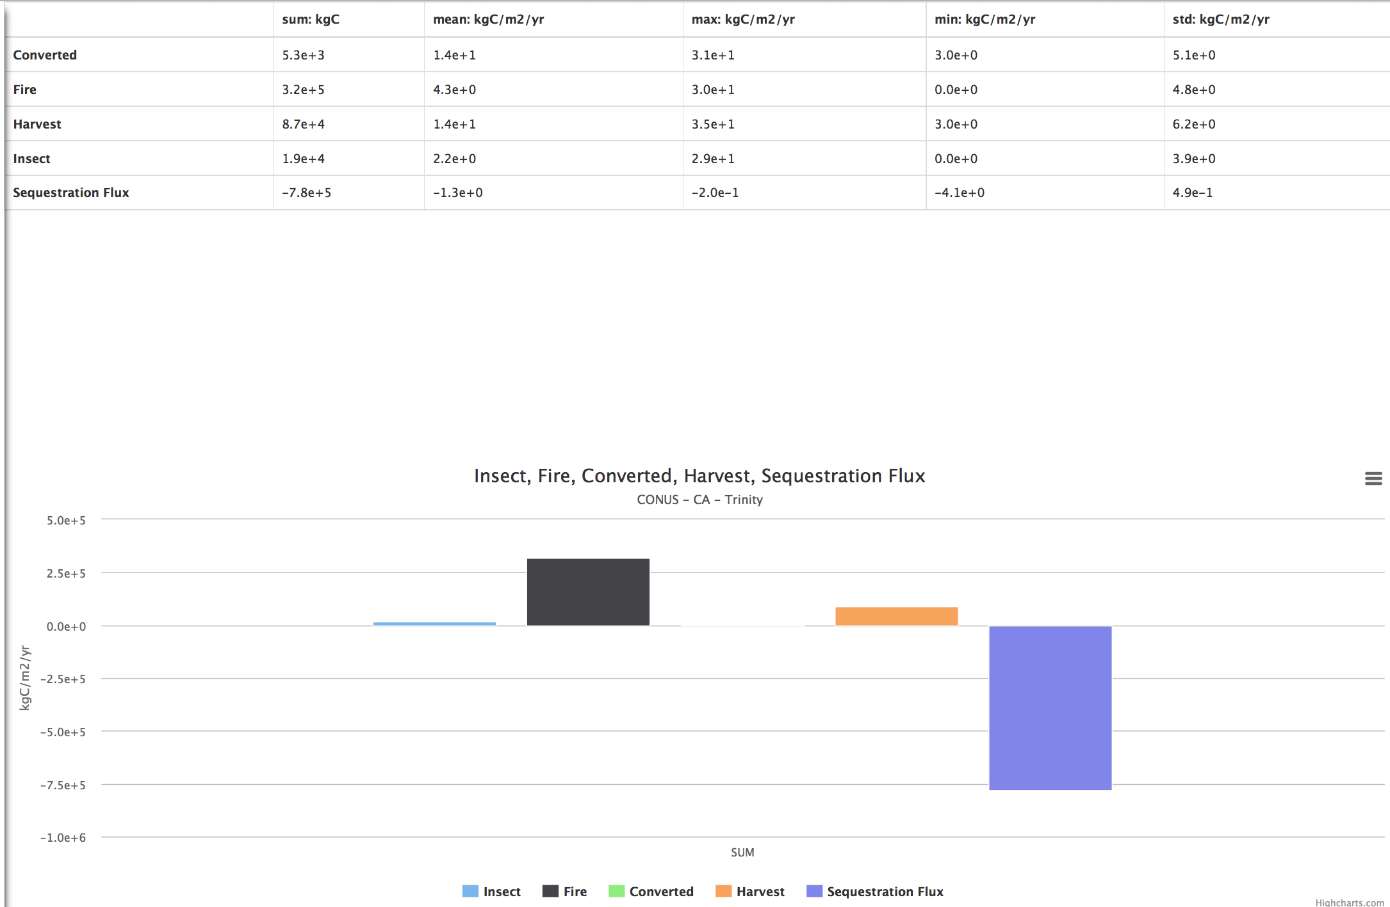
Forest carbon fluxes (Saatchi et al 2010)

Slide 20
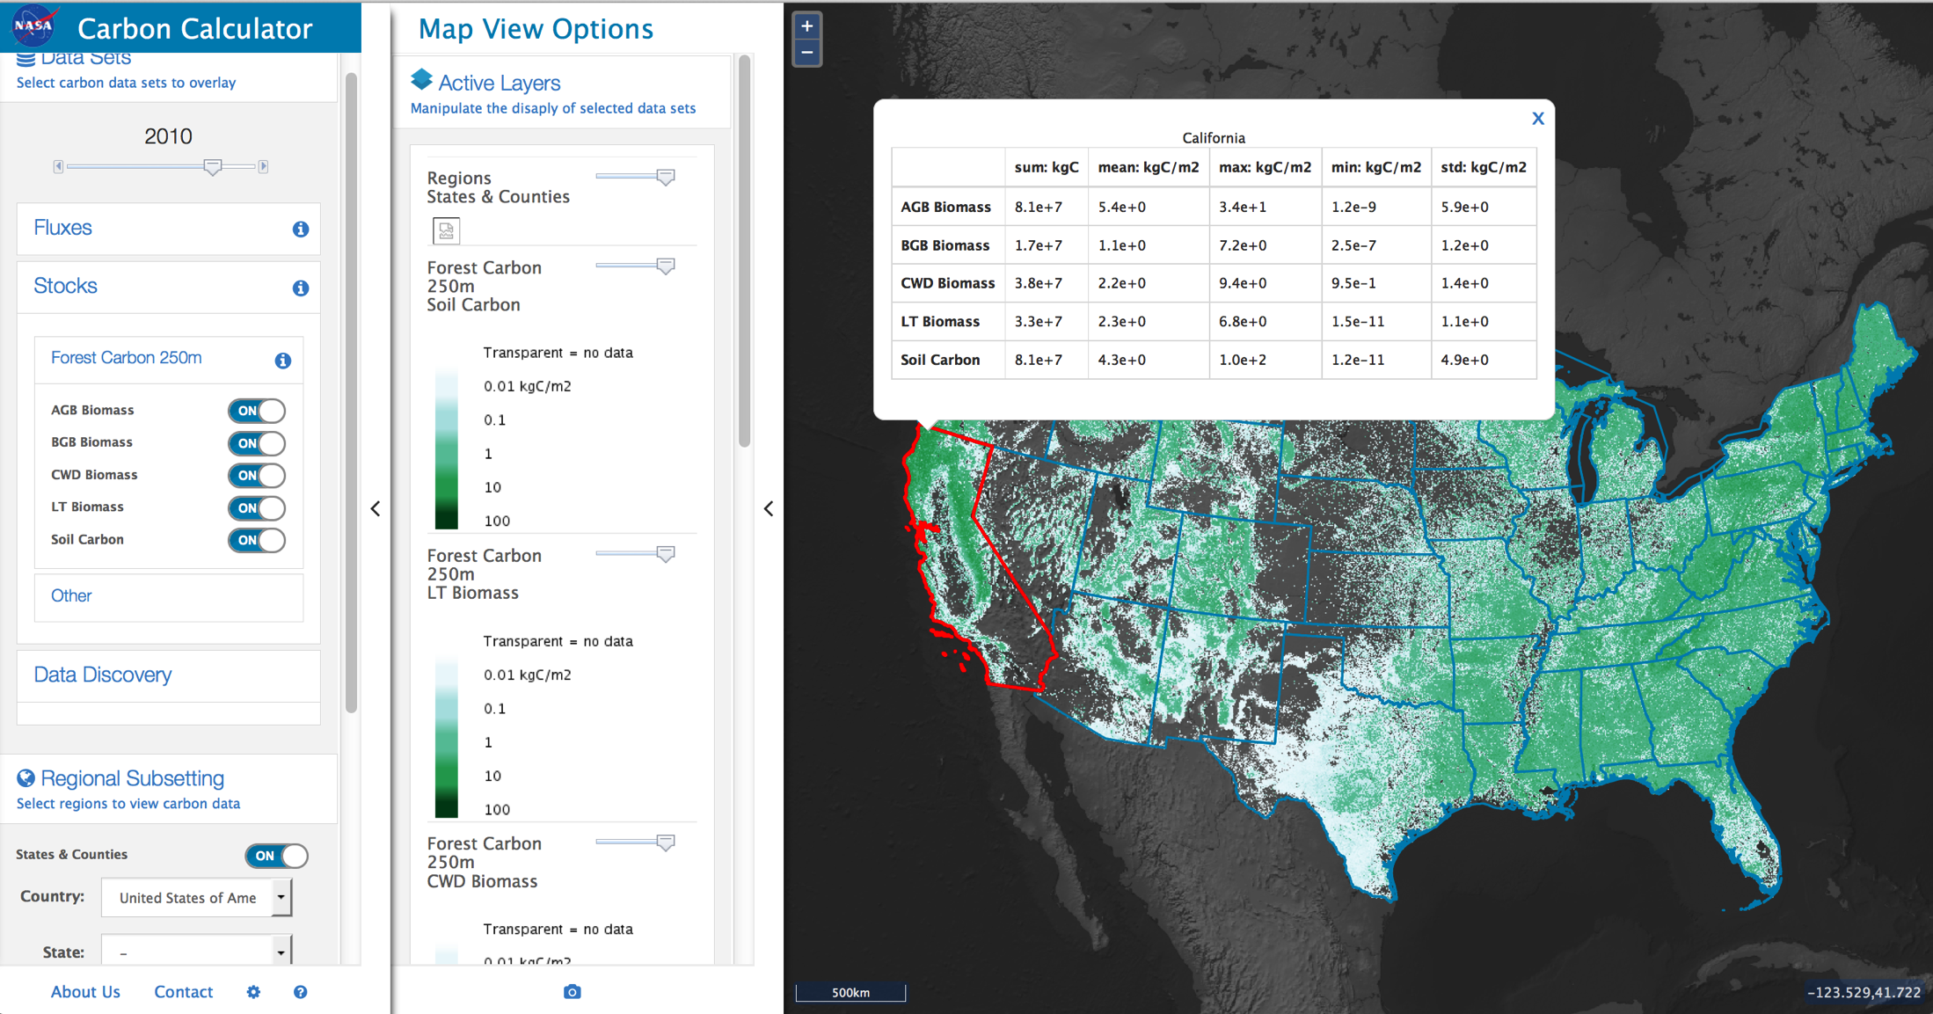
Forest carbon stocks (Saatchi et al 2010)

Slide 21
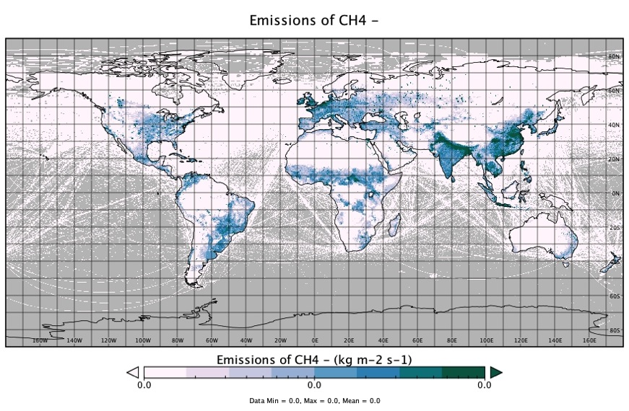
Methane example: Where should we focus observations?
EDGAR 4.2, 2008
Somewhat “covered” by existing high-latitude programs
Tropical sources: wetlands, reservoirs, land use change
Key anthropogenic sources: fossil fuel, livestock, agriwaste in rapidly changing regions
1E-11
1E-10
1E-9

Slide 22
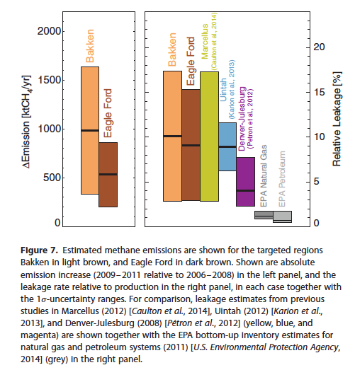
Why the big discrepancy between T-D and B-UP estimates?
Methane: relevance of “top-down” methods to evaluating/improving inventories
T-D
  Biases in the satellite retrievals?
  Biases and other systematics in the inverse estimate?
  Scale mismatch?
  Sectoral attribution?
B-U
  Errors in emission factors?
  Incomplete activity data (unreported and/or excluded)?
Schneising et al 2014, Earth’s Future, 10.1002/2014EF000265
  T-D study quotes 1 sigma uncertainties (how useful compared to the 95% confidence interval standard?)

